Slide 1

Simple & Scalable Sparse
K-means clustering with Feature Ranking
IE 529: Course Project
Team members
Praveen Kumar M (Net ID: pkm4)
Lloyd Fernandes (Net ID: lloydf2)
Omkar Rajendra Mehta (Net ID: omehta2)
Vincent Hoff (Net ID: vhoff2)
December 08, 2021

Slide 2
CLUSTERING
Clustering is one of the most widely used statistical techniques to group data into homogenous clusters, with each cluster sharing similar characteristics.
K-means is a popular method for performing clustering owing to its simplicity, speed and familiarity. The objective is to reduce the within-cluster sums of squared losses (aka WCSS). The steps include:
Assigning each data point to its nearest cluster center
Updating cluster centers by mean of the data points of each cluster

Slide 3
PROBLEM AND MOTIVATION
For high dimensional data :
Signal to noise ratio reduces with each additional feature. Clustering ability deteriorates
Computational and memory requirements increases
Many algorithms have been developed to address these issues as k-means clustering does not work.

Slide 4
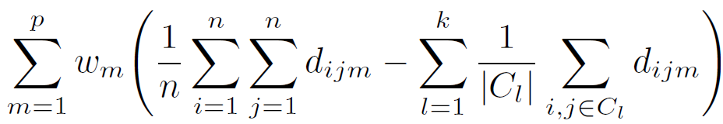
PAST WORK
Filter based methods
Filters the right features which can improve clustering quality before applying clustering.
Wrapper based methods
Select subsets of attributes and identify the best subset post clustering - based on certain cluster quality metrics.
Clustering on Subset of attributes (COSA) : It is a Wrapper based method where weights are assigned to important features which are higher compared to other features.
Sparse k-means (SKM) adds the l-1 norm of weights for calculating weights of the features using gradient descent and selecting features.

Slide 5
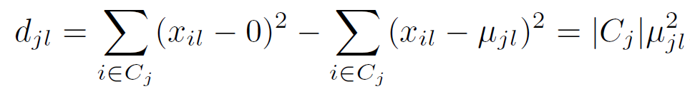
Sparse and Scalable k-means with Feature ranking (SKFR)
The methods described before do not remove the uninformative features and keeps model uninterpretable.
The authors proposed Sparse k-means with feature ranking (SKFR) to eliminate redundant features for clustering and keep interpretability intact.
It ranks features based by ordering d_{l} for each feature l with higher rank for feature with high d_{l}
Top s features are selected, rest features for centroid is set to zero

Slide 6
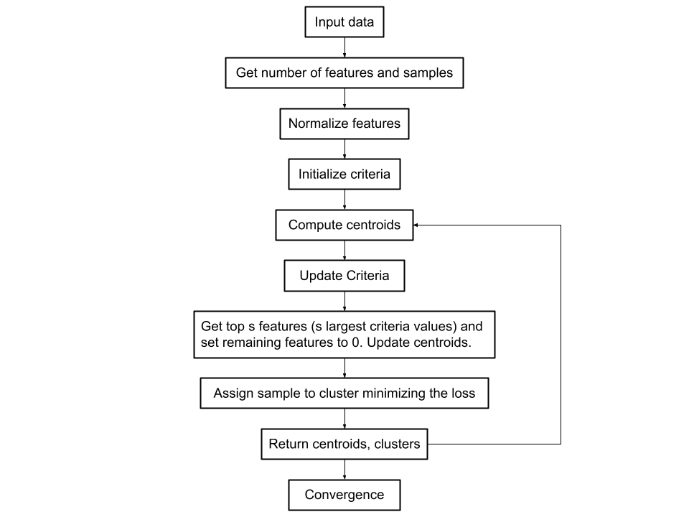
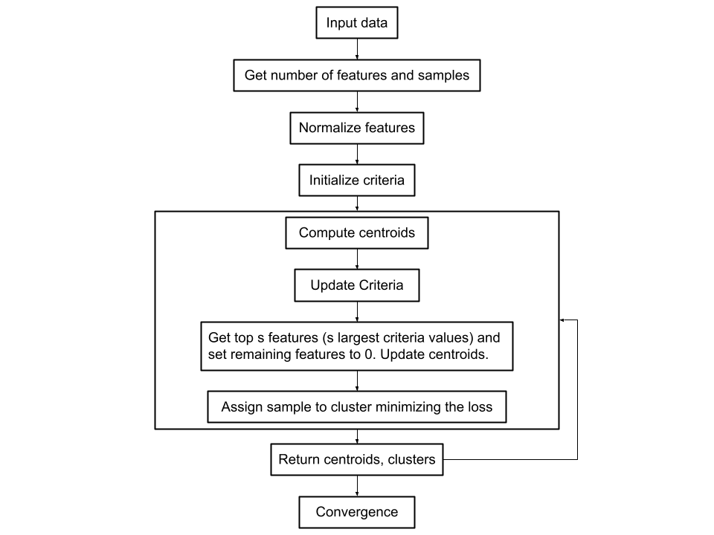
SKFR1 AND SKFR2
SKFR1 (the global version) and SKFR2 (the local version). SKFR2 allows for the set of relevant features to vary across clusters. The informative components are updated within each cluster.

Slide 7
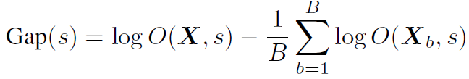
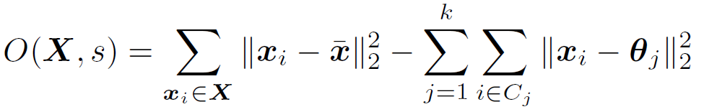
EXTENSIONS TO SKFR
SKFR works well not only with noisy, high dimensional data but also when the data contains missing values and outliers.
K-pod method along with SKFR can be used for imputing missing values, which makes best current guess of its value in each feature.
1-norm distance measure can be used instead of 2-norm distance for trimming outliers, which replaces the previous within-cluster means with within-cluster medians.
Choice of sparsity can be determined by minimizing gap-statistic

Slide 8
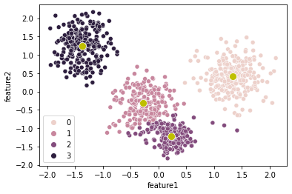
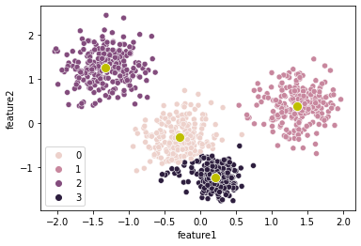
SKFR IN ACTION
Despite the different cluster colors, it can be seen that the two algorithms have very similar performance with some differences in performance visible in the outliers
Notes:
References:
[1] Hugo Steinhaus. Sur la division des corp materiels en parties. Bull. Acad. Polon. Sci, 1(804):
801, 1956.
[2] Katherine A Heller and Zoubin Ghahramani. Bayesian hierarchical clustering. In Proceedings
of the 22nd international conference on Machine learning, pages 297–304, 2005.
[3] Brian Kulis and Michael I Jordan. Revisiting k-means: New algorithms via bayesian nonparametrics.
arXiv preprint arXiv:1111.0352, 2011.
[4] Briana JK Stephenson, Amy H Herring, and Andrew Olshan. Robust clustering with
subpopulation-specific deviations. Journal of the American Statistical Association, 115(530):
521–537, 2020.
[5] Liping Jing, Michael K Ng, and Joshua Zhexue Huang. An entropy weighting k-means algorithm
for subspace clustering of high-dimensional sparse data. IEEE Transactions on knowledge and
data engineering, 19(8):1026–1041, 2007.
[6] René Vidal. Subspace clustering. IEEE Signal Processing Magazine, 28(2):52–68, 2011.
[7] Jocelyn T Chi, Eric C Chi, and Richard G Baraniuk. k-pod: A method for k-means clustering
of missing data. The American Statistician, 70(1):91–99, 2016.
[8] Sohil Atul Shah and Vladlen Koltun. Robust continuous clustering. Proceedings of the National
Academy of Sciences, 114(37):9814–9819, 2017.
[9] Jason Xu, Eric C Chi, Meng Yang, and Kenneth Lange. A majorization–minimization algorithm
for split feasibility problems. Computational Optimization and Applications, 71(3):795–828,
2018.
[10] Stuart Lloyd. Least squares quantization in PCM. IEEE Transactions on Information Theory,
28(2):129–137, 1982.
[11] Ismail Bin Mohamad and Dauda Usman. Standardization and its effects on k-means clustering
algorithm. Research Journal of Applied Sciences, Engineering and Technology, 6(17):3299–
3303, 2013.
[12] Sanjoy Dasgupta. The hardness of k-means clustering. Department of Computer Science and
Engineering, University of California, 2008.
[13] Andrea Vattani. The hardness of k-means clustering in the plane. Manuscript, accessible at
http://cseweb. ucsd. edu/avattani/papers/kmeans_hardness. pdf, 617, 2009.
10
[14] Meena Mahajan, Prajakta Nimbhorkar, and Kasturi Varadarajan. The planar k-means problem
is NP-hard. Theoretical Computer Science, 442:13–21, 2012.
[15] Paul S Bradley and Usama M Fayyad. Refining initial points for k-means clustering. In ICML,
volume 98, pages 91–99. Citeseer, 1998.
[16] Mohammad Al Hasan, Vineet Chaoji, Saeed Salem, and Mohammed J Zaki. Robust partitional
clustering by outlier and density insensitive seeding. Pattern Recognition Letters, 30(11):
994–1002, 2009.
[17] M Emre Celebi, Hassan A Kingravi, and Patricio A Vela. A comparative study of efficient
initialization methods for the k-means clustering algorithm. Expert Systems with Applications,
40(1):200–210, 2013.
[18] David Arthur and Sergei Vassilvitskii. k-means++: The advantages of careful seeding. In
Proceedings of the eighteenth annual ACM-SIAM symposium on Discrete algorithms, pages
1027–1035. Society for Industrial and Applied Mathematics, 2007.
[19] Rafail Ostrovsky, Yuval Rabani, Leonard J Schulman, and Chaitanya Swamy. The effectiveness
of Lloyd-type methods for the k-means problem. Journal of the ACM (JACM), 59(6):28, 2012.
[20] Kevin Beyer, Jonathan Goldstein, Raghu Ramakrishnan, and Uri Shaft. When is “nearest
neighbor” meaningful? In International Conference on Database Theory, pages 217–235.
Springer, 1999.
[21] Charu C Aggarwal, Alexander Hinneburg, and Daniel A Keim. On the surprising behavior of
distance metrics in high dimensional space. In International Conference on Database Theory,
pages 420–434. Springer, 2001.
[22] Ron Kohavi and George H John. Wrappers for feature subset selection. Artificial Intelligence,
97(1-2):273–324, 1997.
[23] Salem Alelyani, Jiliang Tang, and Huan Liu. Feature selection for clustering: A review. In Data
Clustering, pages 29–60. Chapman and Hall/CRC, 2018.
[24] Zheng Zhao and Huan Liu. Spectral feature selection for supervised and unsupervised learning.
In Proceedings of the 24th International Conference on Machine Learning, pages 1151–1157.
ACM, 2007.
[25] Zheng Alan Zhao and Huan Liu. Spectral Feature Selection for Data Mining (Open Access).
Chapman and Hall/CRC, 2011.
[26] Luis Talavera. Feature selection as a preprocessing step for hierarchical clustering. In ICML,
volume 99, pages 389–397. Citeseer, 1999.
[27] Xiaofei He, Deng Cai, and Partha Niyogi. Laplacian score for feature selection. In Advances in
Neural Information Processing Systems, pages 507–514, 2006.
[28] Jennifer G Dy and Carla E Brodley. Feature selection for unsupervised learning. Journal of
Machine Learning Research, 5(Aug):845–889, 2004.
[29] Jerome H Friedman and Jacqueline J Meulman. Clustering objects on subsets of attributes (with
discussion). Journal of the Royal Statistical Society: Series B (Statistical Methodology), 66(4):
815–849, 2004.
[30] Daniela M Witten and Robert Tibshirani. A framework for feature selection in clustering.
Journal of the American Statistical Association, 105(490):713–726, 2010.
[31] Yumi Kondo, Matias Salibian-Barrera, and Ruben Zamar. A robust and sparse k-means
clustering algorithm. arXiv preprint arXiv:1201.6082, 2012.
[32] Šárka Brodinová, Peter Filzmoser, Thomas Ortner, Christian Breiteneder, and Maia Rohm.
Robust and sparse k-means clustering for high-dimensional data. Advances in Data Analysis
and Classification, pages 1–28, 2017.
11
[33] Joshua Zhexue Huang, Michael K Ng, Hongqiang Rong, and Zichen Li. Automated variable
weighting in k-means type clustering. IEEE Transactions on Pattern Analysis and Machine
Intelligence, 27(5):657–668, 2005.
[34] Saptarshi Chakraborty, Debolina Paul, Swagatam Das, and Jason Xu. Entropy weighted power
k-means clustering. In International Conference on Artificial Intelligence and Statistics, pages
691–701. PMLR, 2020.
[35] Saptarshi Chakraborty and Jason Xu. Biconvex clustering. arXiv preprint arXiv:2008.01760,
2020.
[36] David Pollard. Strong consistency of k-means clustering. The Annals of Statistics, pages
135–140, 1981.
[37] Mark P Becker, Ilsoon Yang, and Kenneth Lange. EM algorithms without missing data.
Statistical Methods in Medical Research, 6(1):38–54, 1997.
[38] Kenneth Lange. MM Optimization Algorithms, volume 147. SIAM, 2016.
[39] Minjie Wang and Genevera I Allen. Integrative generalized convex clustering optimization and
feature selection for mixed multi-view data. arXiv preprint arXiv:1912.05449, 2019.
[40] Robert Tibshirani, Guenther Walther, and Trevor Hastie. Estimating the number of clusters in
a data set via the gap statistic. Journal of the Royal Statistical Society: Series B (Statistical
Methodology), 63(2):411–423, 2001.
[41] William M Rand. Objective criteria for the evaluation of clustering methods. Journal of the
American Statistical association, 66(336):846–850, 1971.
[42] Nguyen Xuan Vinh, Julien Epps, and James Bailey. Information theoretic measures for clusterings
comparison: is a correction for chance necessary? In Proceedings of the 26th Annual
International Conference on Machine Learning, pages 1073–1080. ACM, 2009.
[43] Nguyen Xuan Vinh, Julien Epps, and James Bailey. Information theoretic measures for clusterings
comparison: Variants, properties, normalization and correction for chance. Journal of
Machine Learning Research, 11(Oct):2837–2854, 2010.
[44] Jeff Bezanson, Alan Edelman, Stefan Karpinski, and Viral B Shah. Julia: A fresh approach to
numerical computing. SIAM Review, 59(1):65–98, 2017.
[45] Hervé Cardot, Peggy Cénac, and Jean-Marie Monnez. A fast and recursive algorithm for
clustering large datasets with k-medians. Computational Statistics & Data Analysis, 56(6):
1434–1449, 2012.
[46] Bin Zhang. Generalized k-harmonic means–dynamic weighting of data in unsupervised learning.
In Proceedings of the 2001 SIAM International Conference on Data Mining, pages 1–13. SIAM,
2001.
[47] Greg Hamerly and Charles Elkan. Alternatives to the k-means algorithm that find better
clusterings. In Proceedings of the Eleventh International Conference on Information and
Knowledge Management, pages 600–607. ACM, 2002.
[48] Jason Xu and Kenneth Lange. Power k-means Clustering. In Proceedings of the 36th International
Conference on Machine Learning, volume 97 of Proceedings of Machine Learning
Research, pages 6921–6931, Long Beach, California, USA, 09–15 Jun 2019. PMLR.
[49] Clara Higuera, Katheleen J Gardiner, and Krzysztof J Cios. Self-organizing feature maps
identify proteins critical to learning in a mouse model of down syndrome. PloS One, 10(6):
e0129126, 2015.
[50] Eric C Chi, Hua Zhou, and Kenneth Lange. Distance majorization and its applications. Mathematical
programming, 146(1-2):409–436, 2014.
12
[51] Jason Xu, Eric Chi, and Kenneth Lange. Generalized linear model regression under distanceto-
set penalties. In Advances in Neural Information Processing Systems, pages 1385–1395,
2017.
[52] Kevin L Keys, Hua Zhou, and Kenneth Lange. Proximal distance algorithms: Theory and
practice. J. Mach. Learn. Res., 20(66):1–38, 2019.
[53] Heinz H Bauschke and Patrick L Combettes. Convex Analysis and Monotone Operator Theory
in Hilbert Spaces, volume 408. Springer, 2011.
[54] Amir Beck. First-order Methods in Optimization. SIAM, 2017.
[55] Arindam Banerjee, Srujana Merugu, Inderjit S Dhillon, and Joydeep Ghosh. Clustering with
Bregman divergences. Journal of machine learning research, 6(Oct):1705–1749, 2005.

Slide 9
Computational Complexity
Cluster centers determine the rank of each of the features.
Therefore there is no need to go through the entire dataset again to calculate d_{l} when s = p.
The algorithm can be shown to be the same as Lloyd’s algorithm.
Therefore, the SKFR algorithms enjoy the same computational complexity as Lloyd’s algorithm, O(npk), as the sorting algorithm has a logarithmic computational cost.

Slide 10
References
[1] Z. Zhang, K. Lange, and J. Xu, “Simple and scalable sparse k-means clustering via feature ranking,” in Advances in Neural Information Processing Systems, H. Larochelle, M. Ranzato, R. Hadsell, M. F. Balcan, and H. Lin, Eds., vol. 33. Curran Associates, Inc., 2020, pp. 10 148–10 160. [Online]. Available: https://proceedings.neurips.cc/paper/2020/file/735ddec196a9ca5745c05bec0eaa4bf9-Paper.pdf
[2] D. Pollard, “Strong consistency of k-means clustering,” The Annals of Statistics, vol. 9, no. 1, 1981.
[3] J. T. Chi, E. C. Chi, and R. G. Baraniuk, “k-pod: A method for k-means clustering of missing data,” The American Statistician, vol. 70, no. 1, p. 91–99, 2016.
[4] “Skfr-python,” https://github.com/aarunishsinha/SKFR-Python, [Online; accessed 8-December-2021].

